Slide 1
University of Asia Pacific
Artificial Intelligence and Expert Systems
CSE 404
Project - 1
Implementation of a small address Map using A* Search Algorithm
Dr. Nasima Begum
Associate Professor, University of Asia Pacific, Dhaka
Md. Azim Islam | 19201026

Slide 2
Table of Contents - Page
Problem Title - 3
Problem Description - 4
A* Algorithm - 5
The steps of the A* algorithm - 6
A* algorithm visualization - 7
Path Graph Nodes - 8
Heuristic Values - 9
Nodes - 10
Implementation - 11
Input - 12
Output - 13,14
Output Graph - 15
Google Map Path - 15
Literature Review - 17

Slide 3
1. PROBLEM TITLE
Implementation of a small Address Map (from your own home to UAP) using A* Search Algorithm

Slide 4
1.1 PROBLEM DESCRIPTION
Create a graph of the area with nodes representing locations and edges representing routes between locations using google maps.
Assign weights to the edges based on factors such as distance, traffic, road conditions, etc.
Use the A* search algorithm with heuristic functions to find the shortest path from the starting node (home) to the destination node (University of Asia Pacific).
Implement the algorithm in code using a programming language such as Python, Java or any language.
Test the algorithm with sample inputs and fine-tune as necessary.

Slide 5
2. A* ALGORITHM
A* search algorithm is a pathfinding algorithm that can be used to find the shortest path between two nodes on a weighted graph.
It works by searching the graph from the starting node using a heuristic function to evaluate the potential cost of moving to different neighboring nodes.

Slide 6
2.1 A* ALGORITHM STEPS
Initialize the algorithm with the starting node and the destination node.
Generate a set of potential paths that start with the starting node and move towards the destination node.
Use a heuristic function to determine which path to explore first (i.e., the one that has the highest potential to reach the destination node).
While the current node is not the destination node and there are still potential paths to explore, select the path that has the highest potential to reach the destination and explore the next node on that path.
Repeat step 4 until either the destination node is reached, or all potential paths have been explored.

Slide 7
2.2 A* ALGORITHM VISUALIZATION_
Figure 1: Dijkstra’s path finding algorithm vs A* path finding algorithm

Slide 8
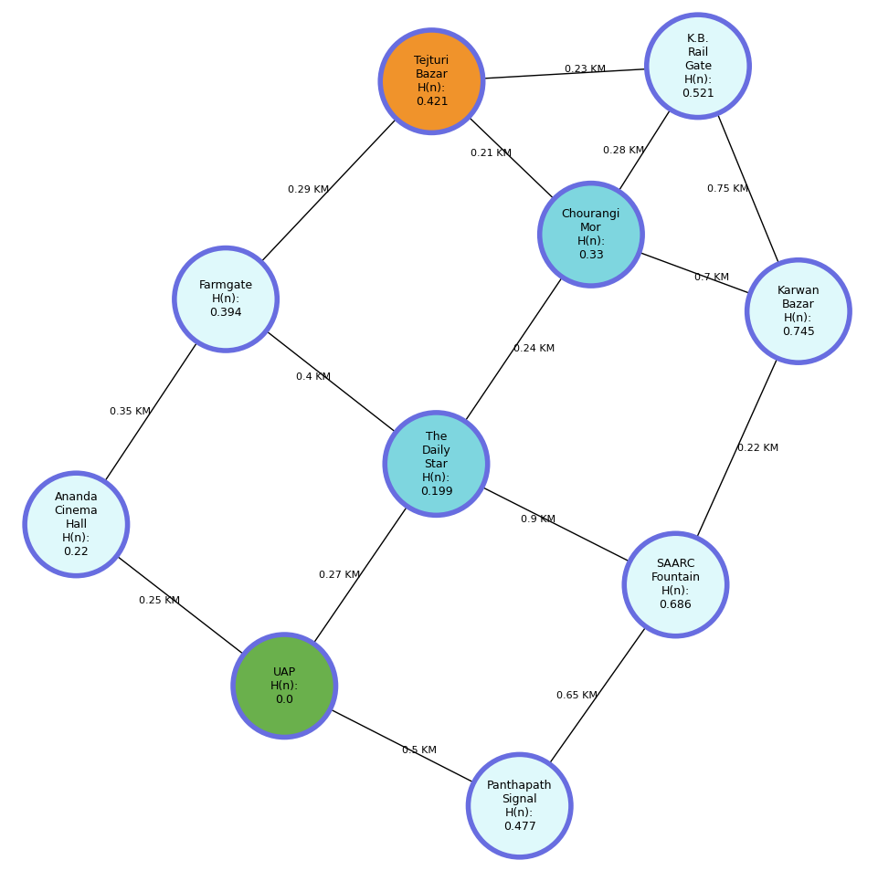
2.3 PATH GRAPH
Figure 2: Path Graph. Start Node, Goal Node, Intermediate Node, Shortest Path Node. H(n) values are in KM.

Slide 9
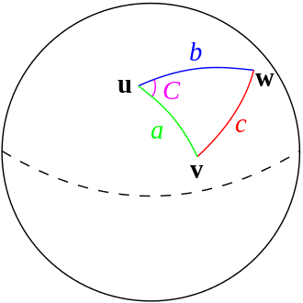
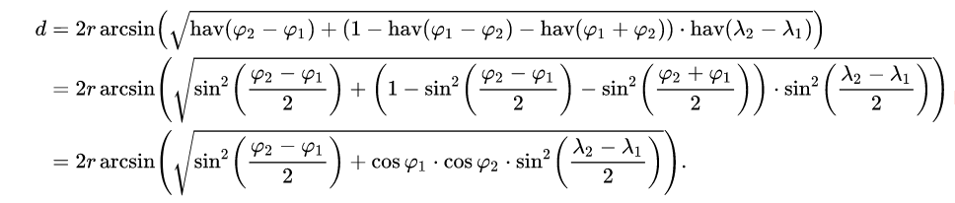
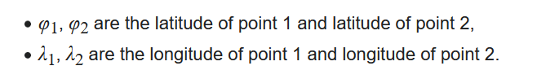
2.4 HEURISTIC VALUE
By using haversine formula we calculate the direct distance between two spherical points.

Slide 10
2.5 NODES
Location Name | Latitude, Longitude
Tejturi Bazar | 23.757262, 90.392418
K.B. Rail Gate | 23.756152, 90.394041
Farmgate | 23.758343, 90.390466
The Daily Star | 23.755619, 90.390917
SAARC Fountain | 23.750060,90.393046
Panthapath Signal | 23.751092, 90.387233
Karwan Bazar | 23.750377, 90.394330
Ananda Cinema Hall | 23.756876, 90.389878
Chourangi Mor | 23.755872, 90.392188
University of Asia Pacific | 23.755039, 90.389071
Location Name | Heuristic Values
Tejturi Bazar | 0.4209 KM
K.B. Rail Gate | 0.5207 KM
Farmgate | 0.3939 KM
The Daily Star | 0.1986 KM
SAARC Fountain | 0.6857 KM
Panthapath Signal | 0.4771 KM
Karwan Bazar | 0.7451 KM
Ananda Cinema Hall | 0.2202 KM
Chourangi Mor | 0.3305 KM
University of Asia Pacific | 0.0000 KM
Table 2,3:Path Graph Nodes Latitude, Longitude, Heuristic values. Start Node, Goal Node

Slide 11
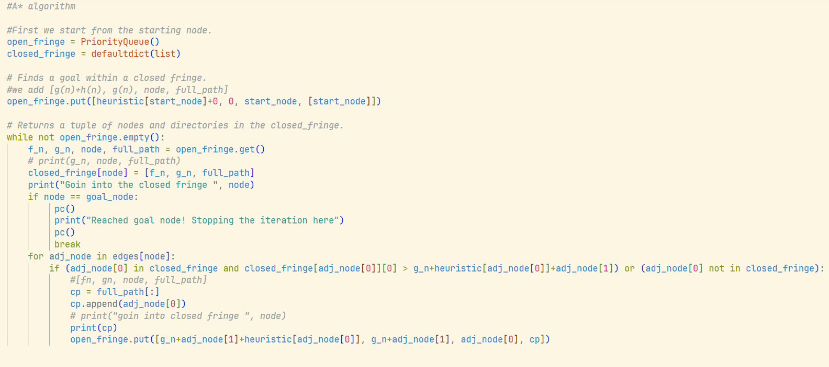
3. IMPLEMENTATION

Slide 12
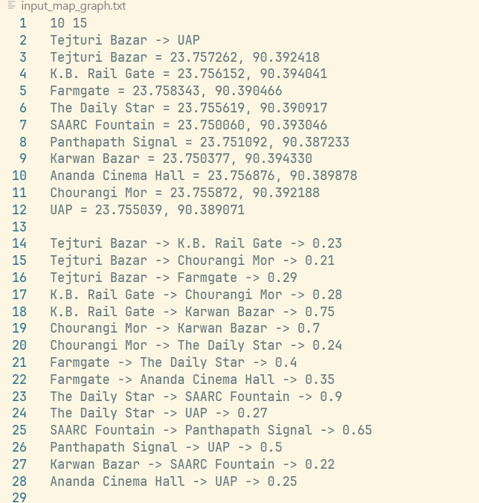
3.1 INPUT

Slide 13
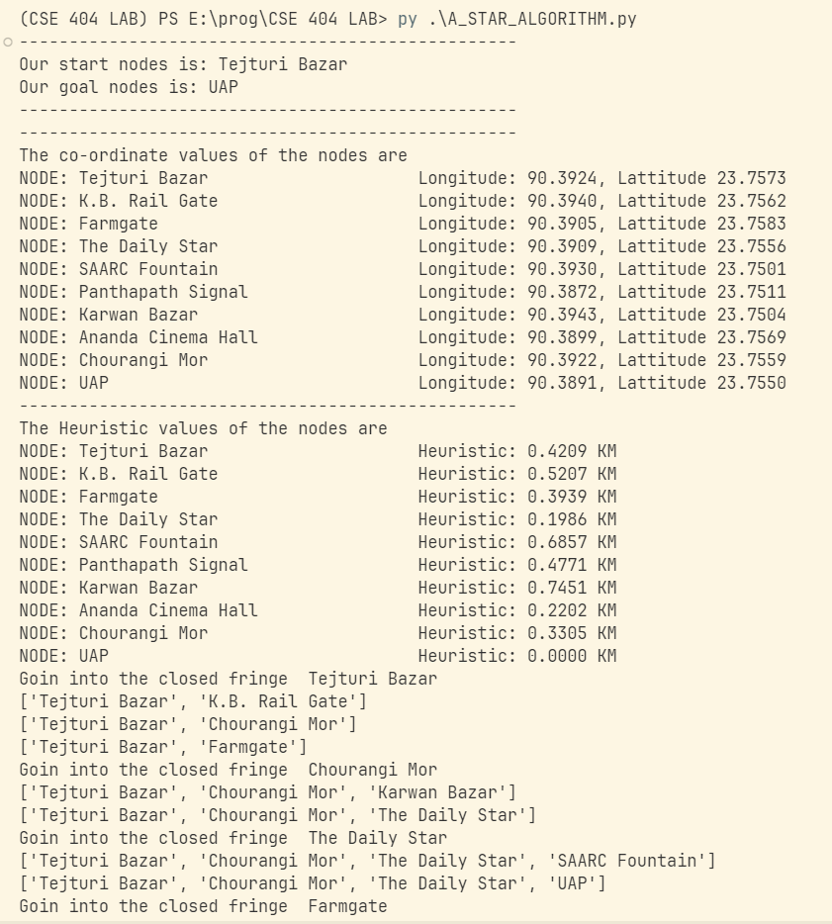
3.2 OUTPUT

Slide 14
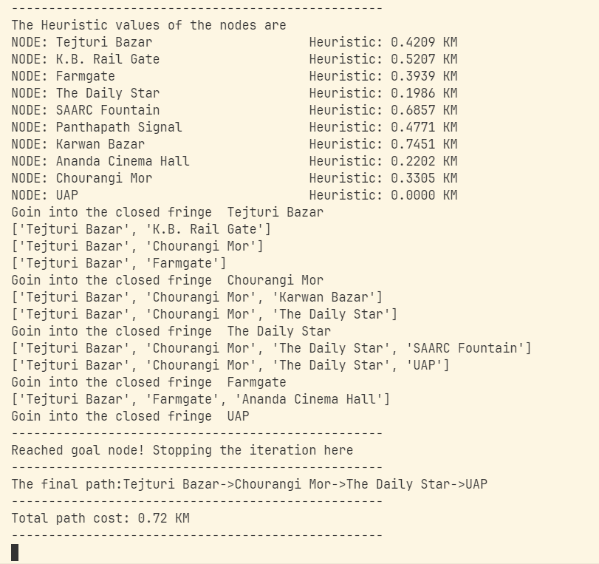
3.2 OUTPUT

Slide 15
3.3 OUTPUT GRAPH
Figure 2: Path Graph. Start Node, Goal Node, Intermediate Node, Shortest Path Node. H(n) values are in KM.

Slide 16
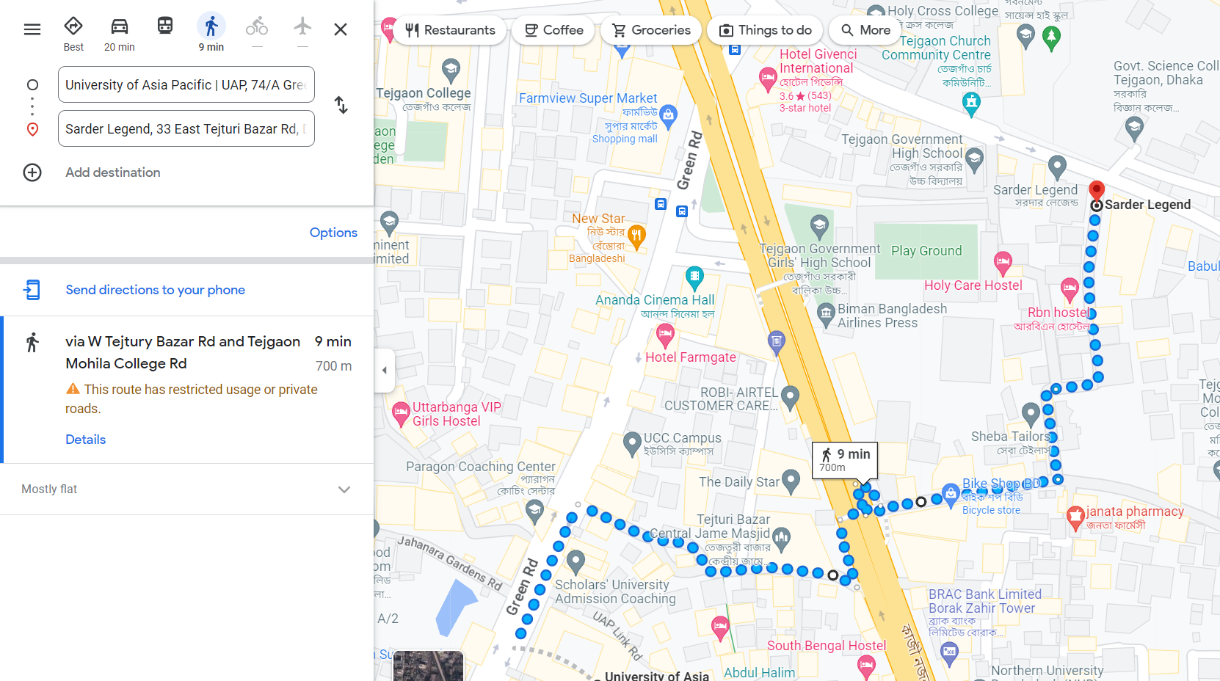
4. GOOGLE MAP PATH

Slide 17
5. LITERATURE REVIEW
"The Haversine Formula," by E. W. Weisstein (MathWorld, 2003)
"The Haversine Formula Revisited," by T. Vincenty (1985)
"The Haversine Formula in JavaScript," by R. Finch (2008)
"A Fast Haversine Algorithm for Short-Range Great-Circle Navigation," by R. W. Sinnott (1984)
Peter Hart, Nils Nilsson, and Bertram Raphael. "A formal basis for the heuristic determination of minimum cost paths." IEEE Transactions on Systems Science and Cybernetics, vol. 4, no. 2, pp. 100-107, July 1968.
Manuela M. Veloso, Ronald A. Brachman, and Paul K. Allen. "A real-time heuristic search algorithm." Artificial Intelligence, vol. 25, no. 1, pp. 97-109, 1985.
Subhrajit Bhattacharya, Jiebo Luo, and Amit K. Roy-Chowdhury. "A fast A* algorithm for video object segmentation." IEEE Transactions on Circuits and Systems for Video Technology, vol. 23, no. 9, pp. 1582-1591, Sept. 2013.

Slide 18
THANK YOU

